Slide 1
Transformers
knowledge

Slide 2
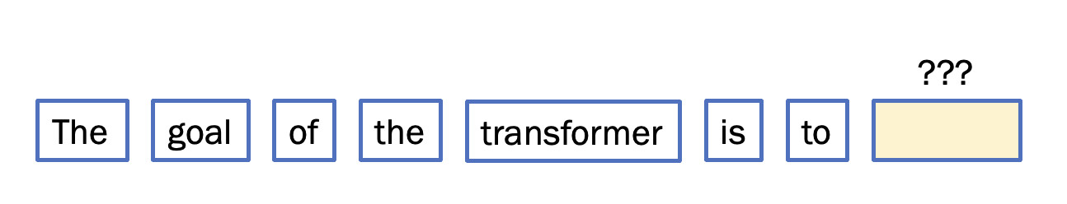
Attention
Multi-Layered Perceptron
Attention
Multi-Layered Perceptron
Attention
Multi-Layered Perceptron

Slide 3
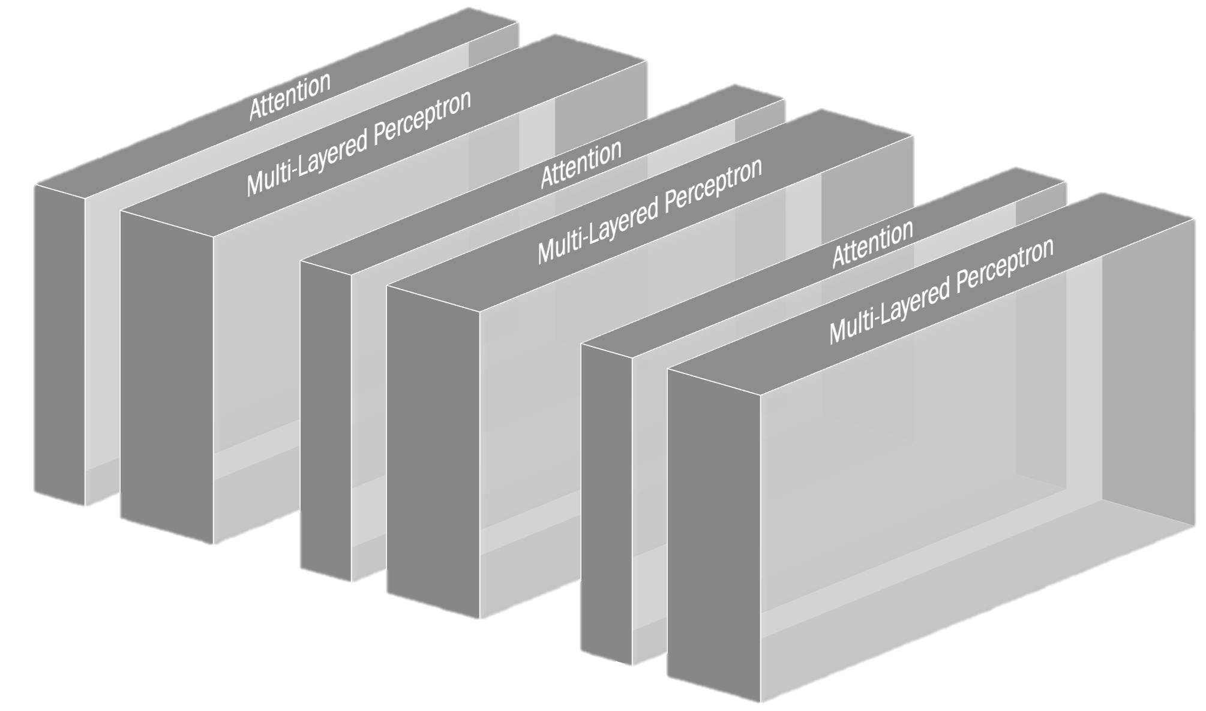
Attention: 1/3
GPT-3
MLP: 2/3
96 heads
96 layers

Slide 4
MLP store facts

Slide 5


Slide 6
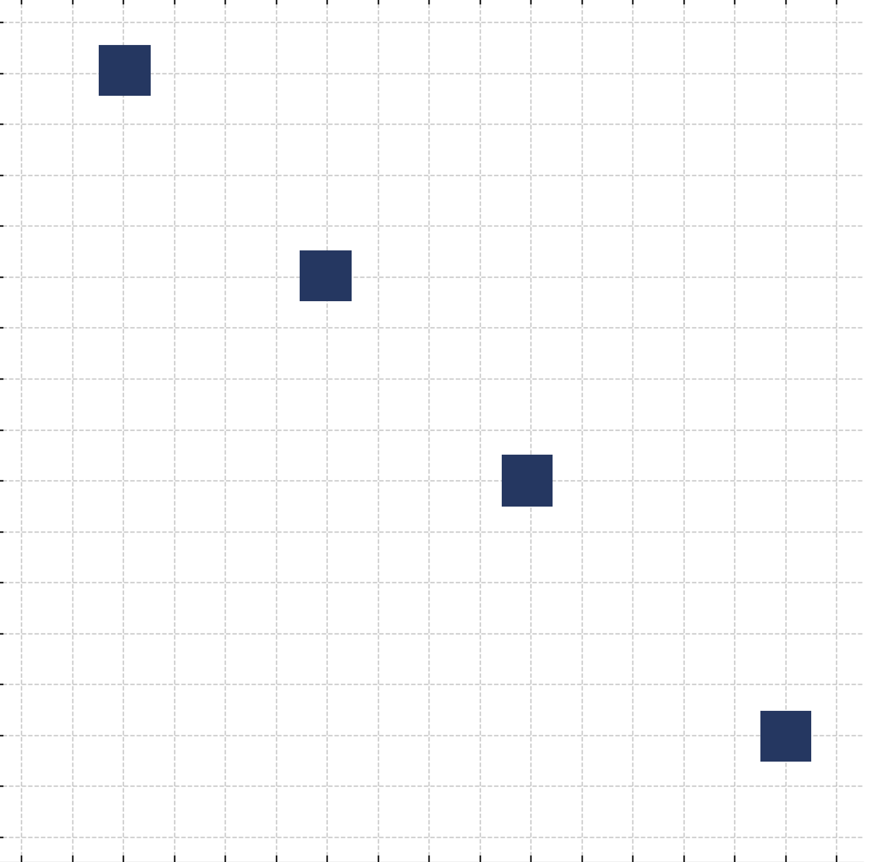



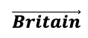

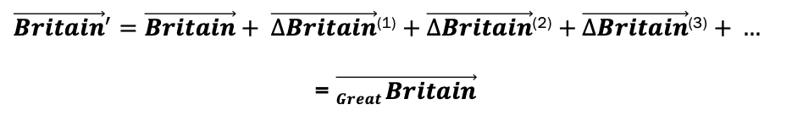
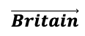
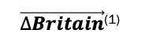
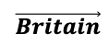
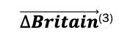


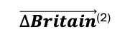
Earlier attention blocks transform „Britain” to „Great Britain”
$$\vec{Britain}$$
$$\vec{Britain}$$
$$\vec{Britain}$$
$$W_{K}^{(1)} W_{Q}^{(1)}$$
$$W_{K}^{(2)} W_{Q}^{(2)}$$
$$W_{K}^{(3)} W_{Q}^{(3)}$$
…
$$W_{V}^{(1)}$$
$$W_{V}^{(2)}$$
$$W_{V}^{(3)}$$
A „Britain” with elements of „Great”
A vector similar to vector representing „Great Britain”
$\vec{∆Britain}$⁽¹⁾
$\vec{∆Britain}$⁽²⁾
$\vec{∆Britain}$⁽³⁾
${\vec{Britain}}^{′}=\vec{Britain}+ \vec{∆Britain}$⁽¹⁾ $+ \vec{∆Britain}$⁽²⁾ $+ \vec{∆Britain}$⁽³⁾ $+ …$
= $\vec{Great Britain}$

Slide 7
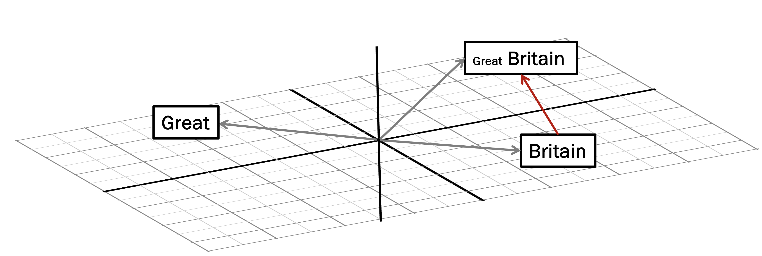
Earlier attention blocks transform „Britain” to „Great Britain”
A „Britain” with elements of „Great”
A vector similar to vector representing „Great Britain”

Slide 8
Our goal is to get further
An island located in the North Atlantic Ocean…
Embed the meaning of a sovereing country
into „Great Britain”
We don’t have such a word in our sentence
So, we need to rely on knowledge stored within our model

Slide 9

How?

Slide 10
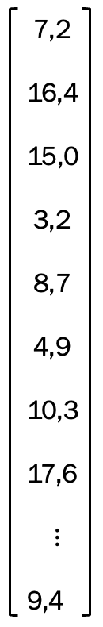
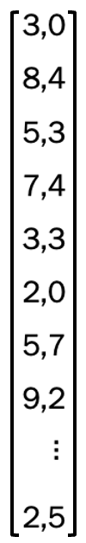
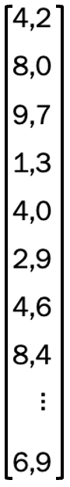
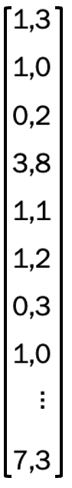
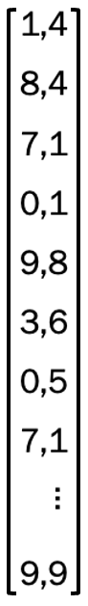
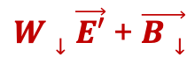

MLP
Linear
ReLU
Linear
+
$W↑ \vec{E}$ + $\vec{B↑}$
$W↓\vec{E′}$ + $\vec{B↓}$
Great Britain
Great Britain: the Island…

Slide 11
Apply this operation to every vector in a sequence
Make Great Britain Great Again
Tokens do not talk to each other this time…

Slide 12
Step 1. First Linear Transformation
From embedding dim to some much higher dim…

Slide 13
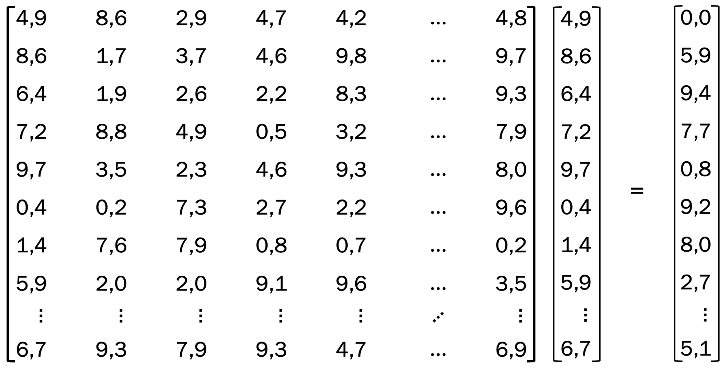
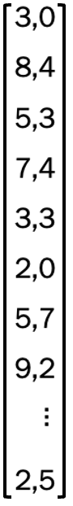
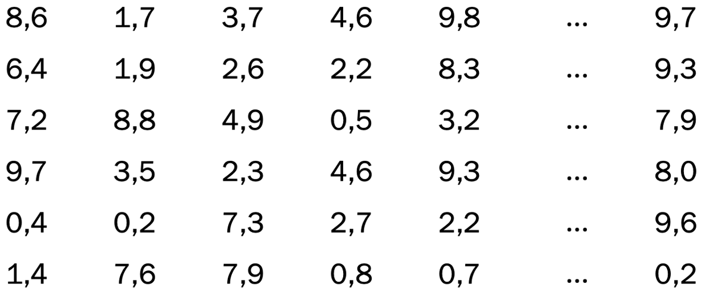
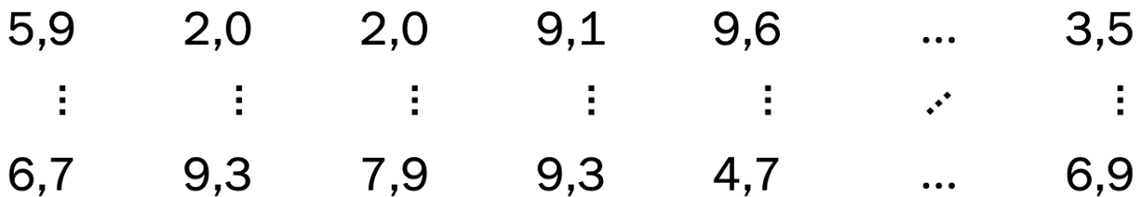
(a, b) x (b, c) = (a, c)
(a, 12288) x (12288, 1) = (a, 1)
a = 4 * 12,288
=

Slide 14
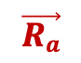
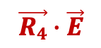
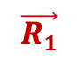
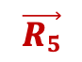
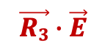


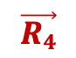
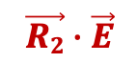
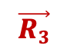
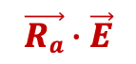
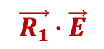
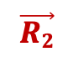

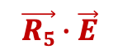
$$\vec{R1}$$
$$\vec{R1}∙\vec{E}$$
$$\vec{R2}$$
$$\vec{R2}∙\vec{E}$$
$\vec{E}$
$$\vec{R3}$$
$$\vec{R3}∙\vec{E}$$
=
$$\vec{R4}$$
$$\vec{R4}∙\vec{E}$$
$$\vec{R5}$$
$$\vec{R5}∙\vec{E}$$
$$⋮$$
$$⋮$$
$$\vec{Ra}$$
$$\vec{Ra}∙\vec{E}$$

Slide 15
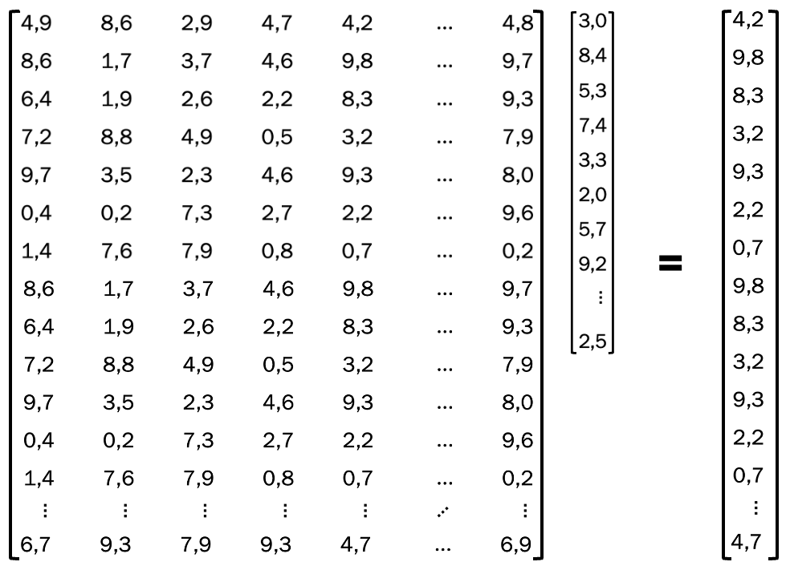
12,288
Island?

Slide 16
12,288
Sovereign country?

Slide 17
12,288
European country?

Slide 18
12,288
A cat?

Slide 19
We also add a Bias term
Useful for „normalization” of terms like „Great Britain”…
+
=

Slide 20
Step 2. Non-Linear Transformation
to help model learn more complex patterns

Slide 21
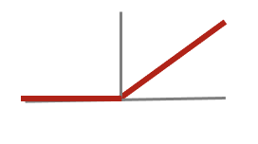
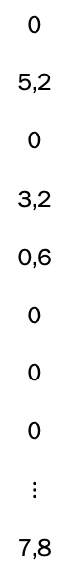
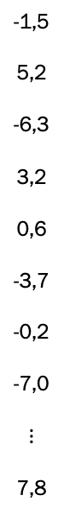
To learn more complex patterns
0: for negatives
x: for positives
-1,5
5,2
-6,3
3,2
0,6
-3,7
-0,2
-7,0
$$⋮$$
7,8
0
5,2
0
3,2
0,6
0
0
0
$$⋮$$
7,8
Plus some technical stuff:
efficient GPU computations
vanishing/exploding gradients managements, etc.
4 * 12,288

Slide 22
Result: active <> not-active neurons
0: for negatives
x: for positives
-1,5
5,2
-6,3
3,2
0,6
-3,7
-0,2
-7,0
$$⋮$$
7,8
0
5,2
0
3,2
0,6
0
0
0
$$⋮$$
7,8
ReLU
4 * 12,288

Slide 23
Step 3. Second Linear Transformation
Down projection: back from high to embedding dim…

Slide 24
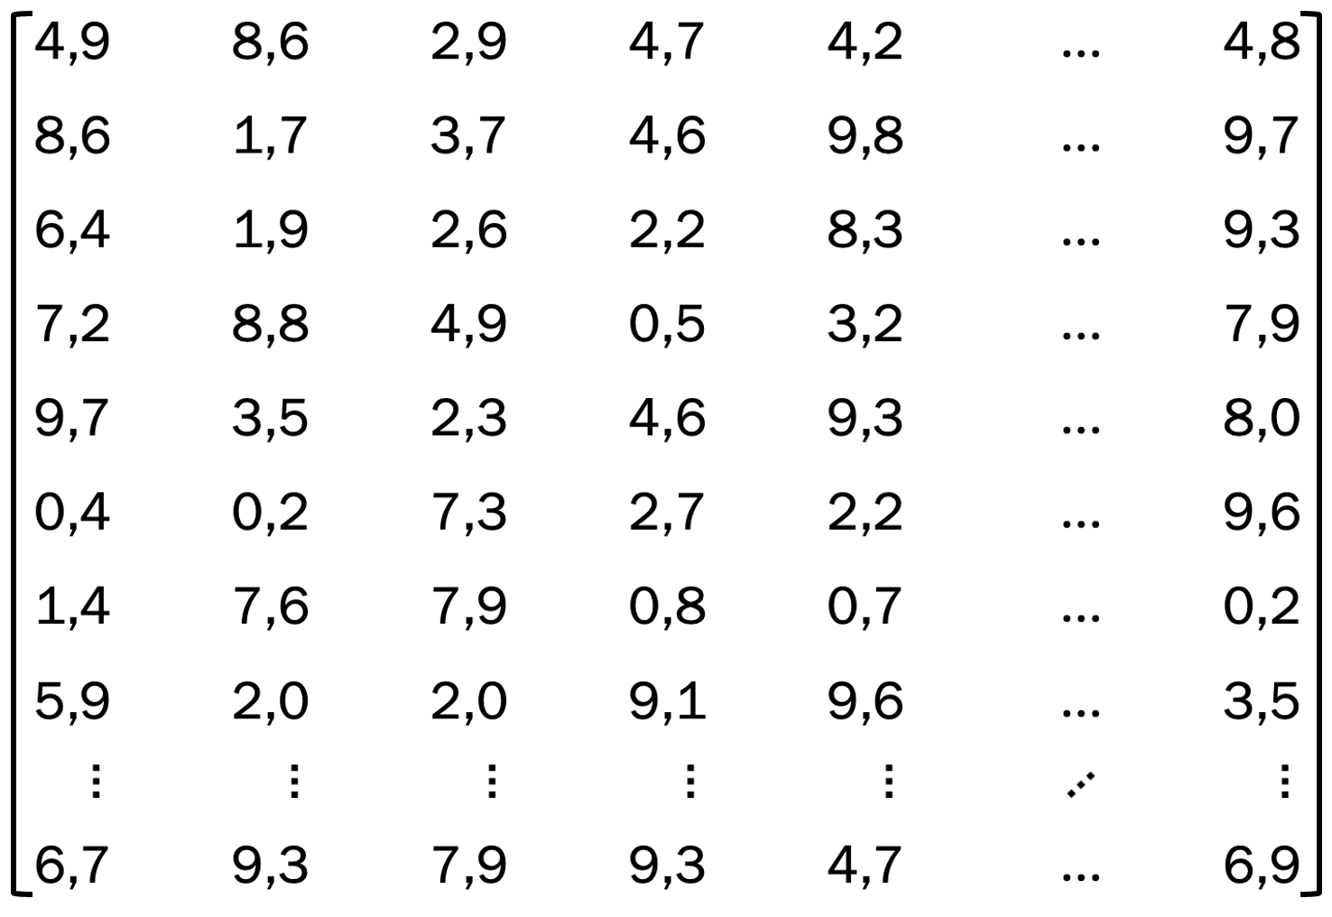
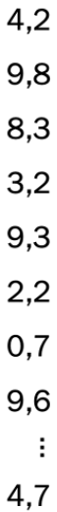
Get back do embedding dimension…
4 * 12,288
+
=
12,288

Slide 25

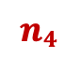
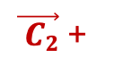
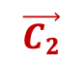
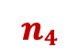
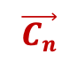
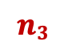
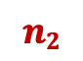
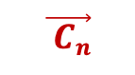
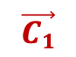
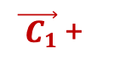
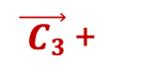












$\vec{ C1}$ +
$\vec{ C2}$ +
$$n1$$
$$n2$$
$\vec{ C3}$ +
$\vec{ C4}$ +
$$\vec{ Cn}$$
$$n3$$
$$n4$$
$$nn$$
$$⋮$$
$$n1$$
$$n2$$
12,288
$$\vec{C1}$$
$$\vec{C2}$$
$$\vec{C3}$$
$$\vec{C4}$$
$$\vec{Cn}$$
+
$$\vec{B}$$
=
12,288
$$⋮$$
$$n3$$
$$n4$$
$$⋮$$
4*12,288
$$nn$$
4*12,288

Slide 26






















All vectors with non-active neurons are cancelled
$\vec{ C1}$ +
$\vec{ C2}$ +
$$n1$$
$$n2$$
$\vec{ C3}$ +
$\vec{ C4}$ +
$$\vec{ Cn}$$
$$n3$$
$$n4$$
$$nn$$
$$⋮$$
$$0$$
$$n2$$
12,288
$$\vec{C1}$$
$$\vec{C2}$$
$$\vec{C3}$$
$$\vec{C4}$$
$$\vec{Cn}$$
+
$$\vec{B}$$
=
12,288
$$⋮$$
$$0$$
$$n4$$
$$⋮$$
4*12,288
$$nn$$
4*12,288

Slide 27

All vectors with non-active neurons are cancelled
$\vec{ C1}$ +
$\vec{ C2}$ +
$$n1$$
$$n2$$
$\vec{ C3}$ +
$\vec{ C4}$ +
$$\vec{ Cn}$$
$$n3$$
$$n4$$
$$nn$$
$$⋮$$
$$0$$
$$n2$$
12,288
$$\vec{C1}$$
$$\vec{C2}$$
$$\vec{C3}$$
$$\vec{C4}$$
$$\vec{Cn}$$
+
$$\vec{B}$$
=
$$⋮$$
$$0$$
$$n4$$
$$⋮$$
cat?
$$nn$$

Slide 28
All vectors with non-active neurons are cancelled
$\vec{ C1}$ +
$\vec{ C2}$ +
$$n1$$
$$n2$$
$\vec{ C3}$ +
$\vec{ C4}$ +
$$\vec{ Cn}$$
$$n3$$
$$n4$$
$$nn$$
$$⋮$$
$$0$$
$$n2$$
12,288
$$\vec{C1}$$
$$\vec{C2}$$
$$\vec{C3}$$
$$\vec{C4}$$
$$\vec{Cn}$$
+
$$\vec{B}$$
=
$$⋮$$
$$0$$
$$n4$$
$$⋮$$
Island?
$$nn$$

Slide 29
All vectors with non-active neurons are cancelled
$\vec{ C1}$ +
$\vec{ C2}$ +
$$n1$$
$$n2$$
$\vec{ C3}$ +
$\vec{ C4}$ +
$$\vec{ Cn}$$
$$n3$$
$$n4$$
$$nn$$
$$⋮$$
$$0$$
$$n2$$
12,288
$$\vec{C1}$$
$$\vec{C2}$$
$$\vec{C3}$$
$$\vec{C4}$$
$$\vec{Cn}$$
+
$$\vec{B}$$
=
$$⋮$$
$$0$$
$$n4$$
$$⋮$$
Car?
$$nn$$

Slide 30
All vectors with non-active neurons are cancelled
$\vec{ C1}$ +
$\vec{ C2}$ +
$$n1$$
$$n2$$
$\vec{ C3}$ +
$\vec{ C4}$ +
$$\vec{ Cn}$$
$$n3$$
$$n4$$
$$nn$$
$$⋮$$
$$0$$
$$n2$$
12,288
$$\vec{C1}$$
$$\vec{C2}$$
$$\vec{C3}$$
$$\vec{C4}$$
$$\vec{Cn}$$
+
$$\vec{B}$$
=
$$⋮$$
$$0$$
$$n4$$
$$⋮$$
England?
$$nn$$

Slide 31
What is being added?
An Island, sovereign country, with England…

Slide 32
MLP adds a new meaning to the „Britain”
Basing on a stored knowledge, not the other tokens

Slide 33


MLP
Linear
ReLU
Linear
+
$\vec{W↑}\vec{E}$ + $\vec{B↑}$
$\vec{W↓}\vec{E′}$ + $\vec{B↓}$
Great Britain
Great Britain: the Island…

Slide 34

GPT-3: total weights count = 175,181,291,520

